Slide 1

Google AI- ML Virtual Intership
by
M.VEDHANATH REDDY
Roll No. 224G1A32B0
Department of Computer Science and Engineering (Data Science)
Srinivasa Ramanujan Institute of Technology
(Affiliated to JNTUA & Approved by AICTE) (Accredited by NAAC with ‘A’ Grade & Accredited by NBA (EEE, ECE & CSE)
Rotarypuram Village, B K Samudram Mandal, Ananthapuramu – 515701.
2024 - 2025

Slide 2


Contents
Google AI-ML Virtual Internship
Introduction
Modules
Modules explanation
Conclusion
224G1A32B0

Slide 3
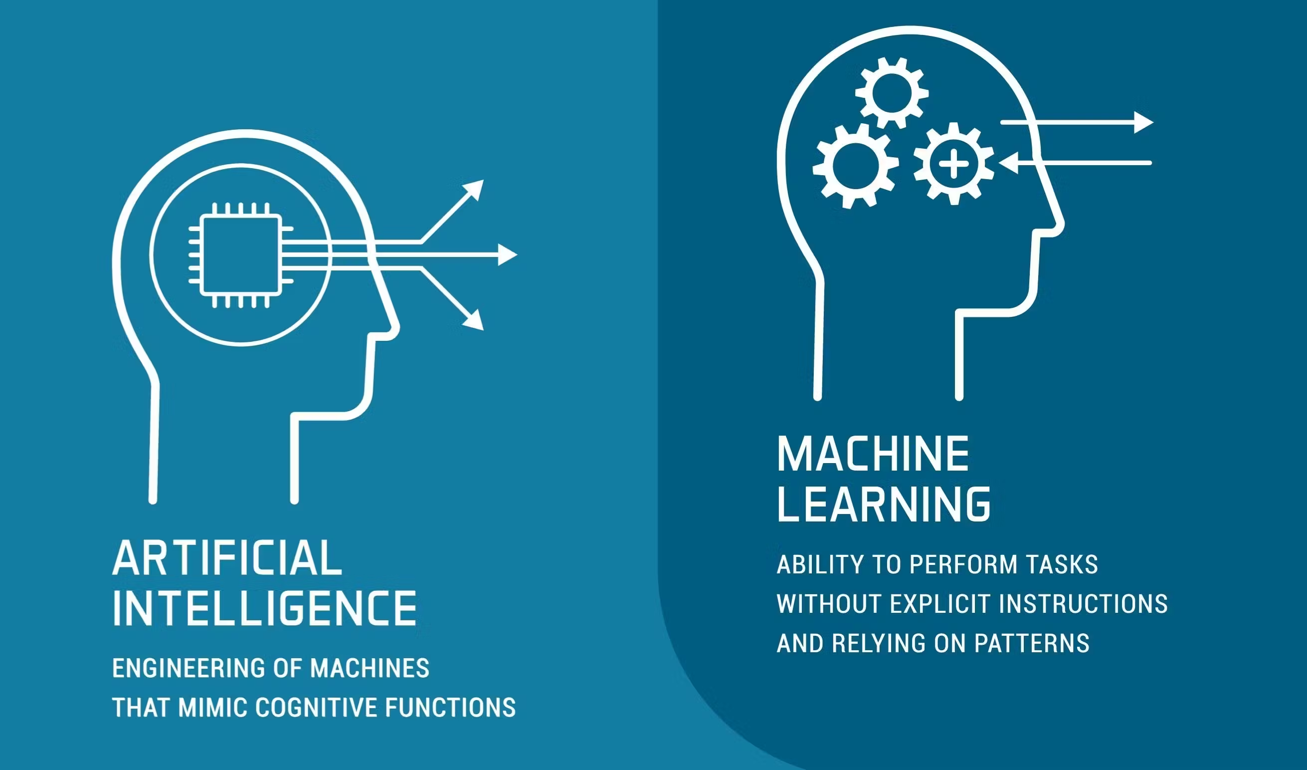
Introduction
Google AI-ML Virtual Internship
WHAT IS AI-ML ???
The word Artificial Intelligence comprises of two words "Artificial" and "Intelligence". Artificial refers to something which is made by humans or non-natural thing and Intelligence means the ability to understand or think.AI is the study of how to train the computers so that computers can do things which at present human
can do better.
224G1A32B0

Slide 4
Introduction
Google AI-ML Virtual Internship
MACHINE LEARNING is an application of Artificial intelligence in which machine can automatically
learn on its own and improve from experience without being explicitly programmed.ML gives computer that
which makes it more similar to humans: The ability to learn.Machine learning is a subset of Al that focuses
on a narrow range of activities.
224G1A32B0

Slide 5
Modules
Google AI-ML Virtual Internship
Brief introduction on AI-ml and its types
Introduction to Neural Networks
Performing object detection
Introduction to product image search
Image Classification
Use cases
224G1A32B0

Slide 6
AI and it’s types
Google AI-ML Virtual Internship
Type 1:
Narrow AI: AI designed to complete very specific actions; unable to
independently learn.
Artificial General Intelligence: AI designed to learn, think and
perform at similar levels to humans.
Artificial Superintelligence: AI able to surpass the knowledge and
capabilities of humans.
Type 2:
Reactive Machine AI: AI capable of responding to external stimuli in
real time; unable to build memory or store information for future.
Limited Memory AI: AI that can store knowledge and use it to learn
and train for future tasks.
Theory of Mind AI: AI that can sense and respond to human emotions,
plus perform the tasks of limited memory machines.
Self-Aware AI: AI that can recognize others’ emotions, plus has sense
of self and human-level intelligence; the final stage of AI.
224G1A32B0

Slide 7
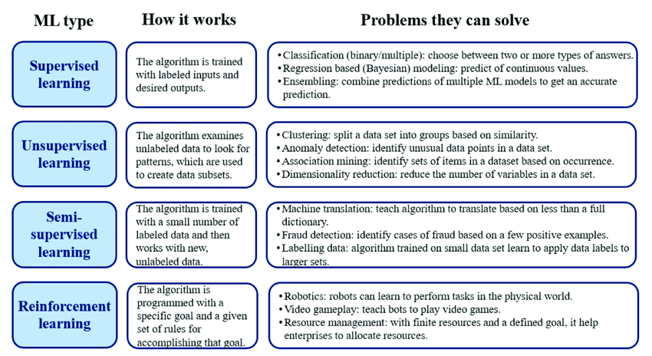
ML and it’s types
Google AI-ML Virtual Internship
224G1A32B0

Slide 8
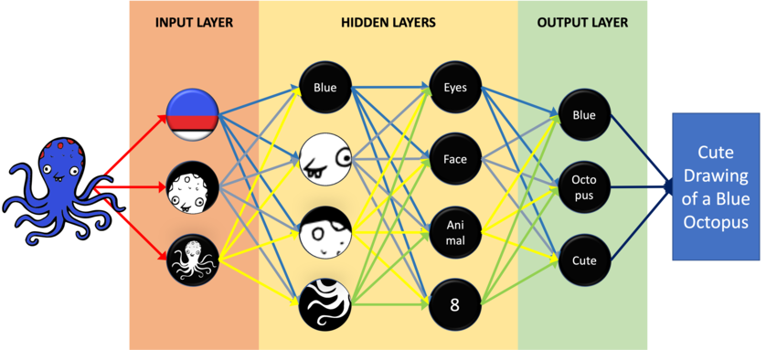
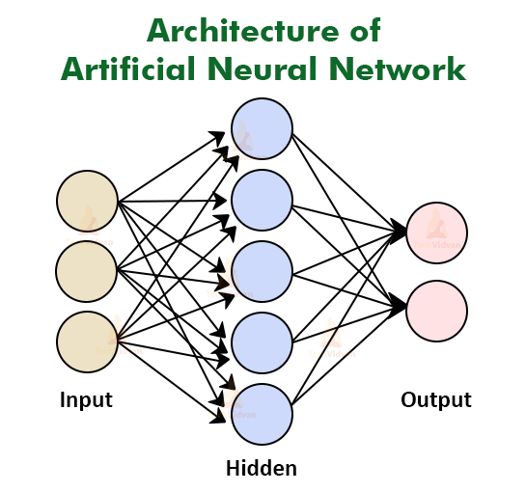
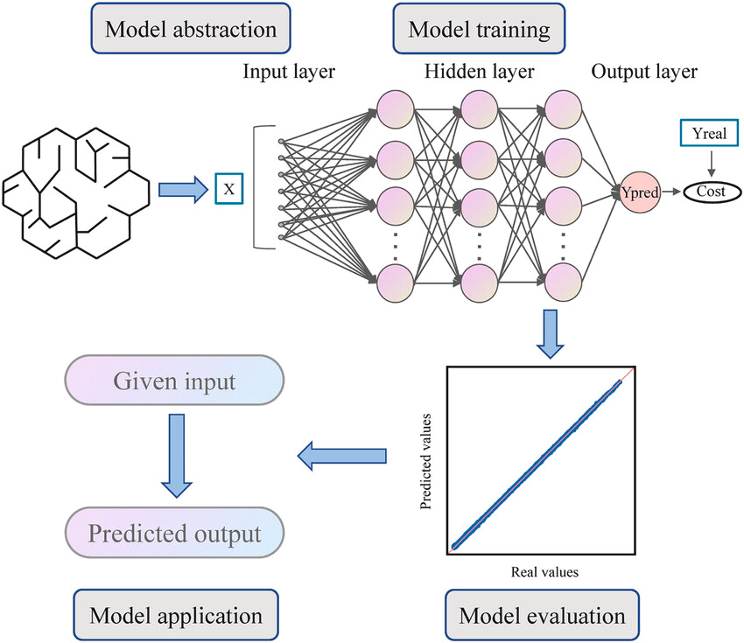
Introduction to Neural Networks
Google AI-ML Virtual Internship
224G1A32B0

Slide 9
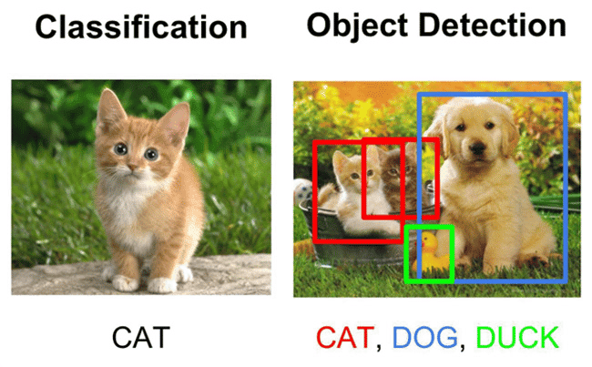
Performing object detection
Google AI-ML Virtual Internship
Object detection is a technology that falls under the broader domain of Computer Vision. It deals with identifying and tracking objects present in images and videos. Object detection has multiple applications such as face detection, vehicle detection, pedestrian counting, self-driving cars, security systems, etc.
Object detection, involves three main stages: the feature extraction stage, the classification stage and the detection or localization stage. In the literature the feature and classification stages are counted as one called the classification stage
224G1A32B0

Slide 10
Introduction to product image
Google AI-ML Virtual Internship
INTRODUCTION TO PRODUCT IMAGE SEARCH :
A CNN, or Convolutional Neural Network, is a type of artificial intelligence, It is mainly used for analyzing
images. It works by breaking the image into small pieces and looking for patterns. These patterns help it recognize
things in the image, like edges or shapes.
While Product Search is finding a specific product with a clear intention, Product Discovery is the journey where shoppers can also view other related items they may want.
The main objective involves in product image search is image recognition which is also involved in neuralnetworks and deep learning.
224G1A32B0

Slide 11
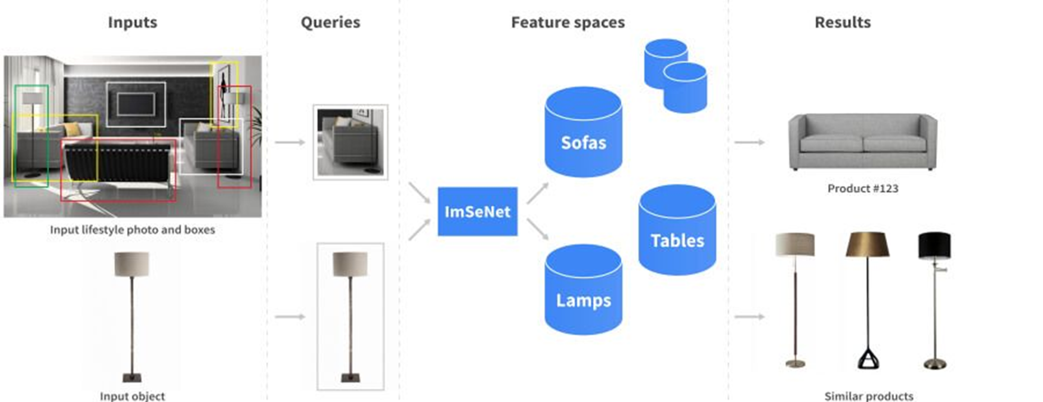
Continue…
Google AI-ML Virtual Internship
Three steps to follow to train Image Recognition thoroughly
Step 1: Preparation of the training dataset. ...
Step 2: Preparation and understanding of how Convolutional Neural Network models work. ...
Step 3: Evaluation and validation of the training results of your system.
224G1A32B0

Slide 12
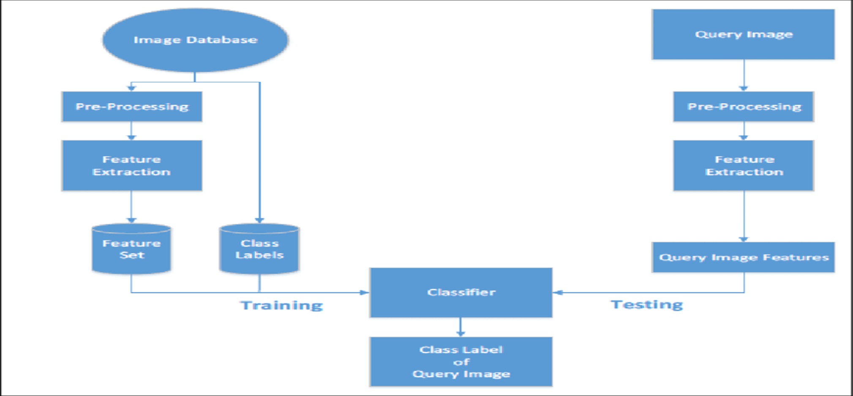
Image classification
Google AI-ML Virtual Internship
Here's how image classification works, step-by-step:
Pre-processing: prepping your data. ...
Object detection: locating objects within the image set. ...
Object recognition and training: labeling located images. ...
Object classification: your model is ready to classify your images...
Connecting to an AI workflow
224G1A32B0

Slide 13
Image classification continue…
Google AI-ML Virtual Internship
Image classification is the task of categorizing images into one or multiple predefined classes.
Depending on the interaction between the analyst and the computer during classification, there are two methods of classification: supervised and unsupervised. They both can be either object-based or pixel-based.
Image classification, at its very core, is the task of assigning a label to an image from a predefined set of categories. Practically, this means that our task is to analyze an input image and return a label that categorizes the image. The label is always from a predefined set of possible categories.
224G1A32B0

Slide 14
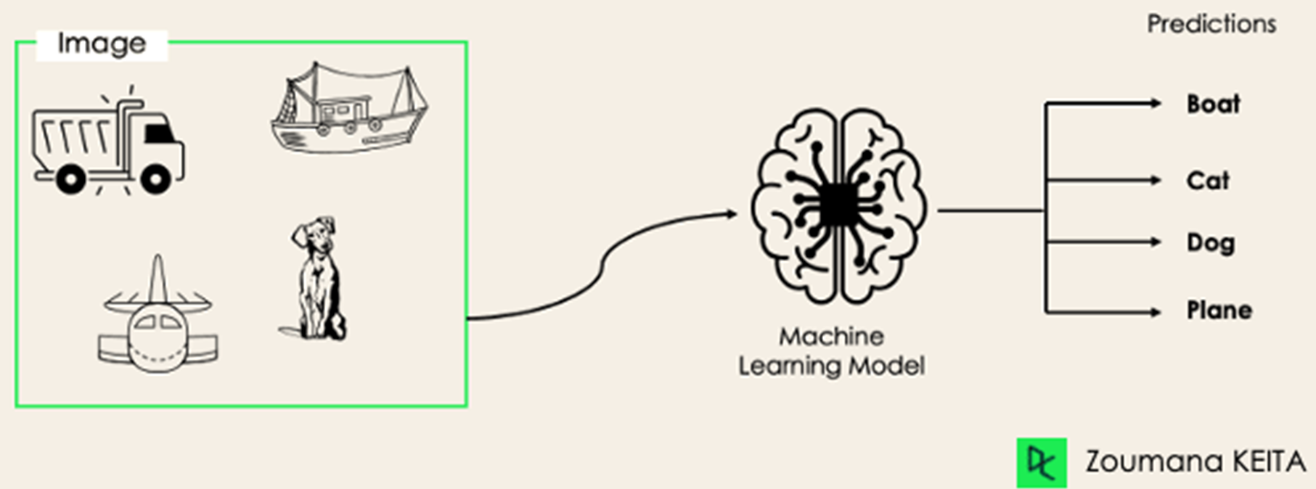
Image classification continue…
Google AI-ML Virtual Internship
224G1A32B0

Slide 15
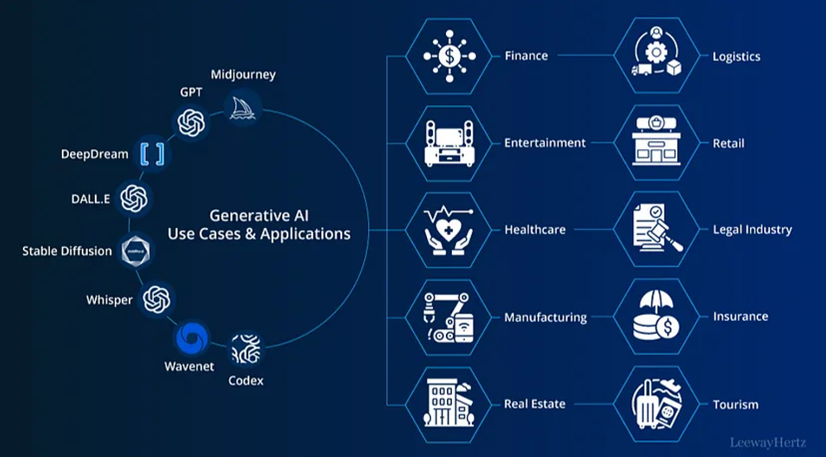
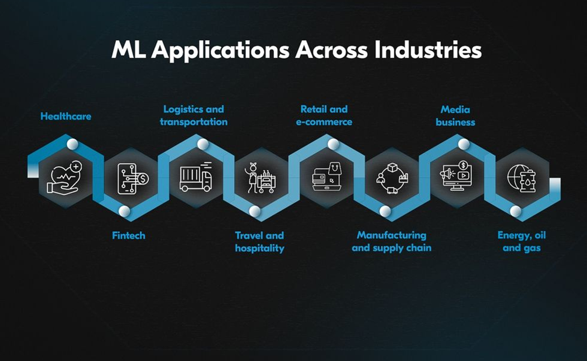
AI-ML use cases
Google AI-ML Virtual Internship
224G1A32B0

Slide 16
Conclusion
Google AI-ML Virtual Internship
Conclusion:
Finally we can say that the Artificial Intelligence (AI-ML) is the intelligence of machines and the branch of Computer Science that aims to create it. AI where an intelligent agent is a system that perceives it's environment and takes actions that maximize the chances of it’s success.
AI-ML is like giving a computer or a robot a brain that not only computes but also ‘thinks’.
224G1A32B0

Slide 17
Reference
Google AI-ML Virtual Internship
Reference:
https://aicte-internship.eduskillsfoundation.org/
224G1A32B0

Slide 18

Internship certificate
Google AI-ML Virtual Internship
Internship certificate:
224G1A32B0

Slide 19

Google Andriod Developer Virtual Internship
Any Queries?
224G1A3279

Slide 20
Google Andriod Developer Virtual Internship
Thank You!!!
224G1A3279

